Slide 1
DETECTING CYBERBULLYING THROUGH TWEETS AND NETWORK GRAPHS
YAMINI RANGANATHAN RACHEL PORTER YASHPREET MALHOTRA

Slide 2
PROJECT OBJECTIVES
Create a model that can automatically successfully detect instances of bullying tweets
Explore the possibility of an increase in cyberbullying incidents due to the pandemic and high social media usage

Slide 3
STATEMENT OF VALUE
Model capable of automatically recognizing harassing comments on social platforms create a safer spaces online for earlier and successful reporting/detection of cyberbullying attempts is of key importance to targets of cyberbullying– particularly adolescents’ mental well-being
By building an algorithm that can analyze Tweets exhibiting themes of bullying, it will be possible for individuals, parents, caregivers, and medical professionals to analyze social media posts for linguistic clues that signal deteriorating mental health far before traditional approaches

Slide 4
SOCIAL MEDIA & CYBERBULLYING IN US DURING COVID19
20% increase in social media usage has also been observed during the covid19 pandemic
Pew Research Center studies indicate that 72% of people now use social media -Facebook, Twitter, Snapchat, YouTube, and Instagram
As of January 2020, 44 % of all internet users have experienced online harassment
In April 2021 an AI company dedicated to monitoring hate speech online noted a 70% increase in the amount of hate speech among teens & children in online chats
Bullying victims are six times more likely to be diagnosed with a serious illness, or develop mental health issues

Slide 5
REVIEW OF THE STATE OF THE ART AND RELEVANT WORKS
NLP techniques & supervised machine learning was used to detect cyberbullying by not considering sarcastic content as cyberbullying but by identifying the themes or categories associated with cyberbullying (Pereraa & Fernandob, 2020)
Automatic detection of cyberbullying in social media text by identifying different types of bullying (Van Hee et al, 2018)
A Hybrid Model for Detecting Cyberbullying in the Spanish Language by creating different models that combine the Lexicons and ML approach (Lepe-Faúndez et al, 2021)
A Multichannel Deep Learning Framework for Cyberbullying Detection on Social Media uses the bidirectional gated recurrent unit (BiGRU), transformer block, and convolutional neural network (CNN), to classify Twitter comments into two categories: aggressive and not aggressive (Munif Alotaibi et al. 2021)
SOSNet: A Graph Convolutional Network Approach to Fine-Grained Cyberbullying Detection focuses on the ability to discern what specific quality of the victim the cyberbully is attacking (Wang et al, 2020)

Slide 6
APPROACH
Dataset: FINE-GRAINED BALANCED CYBERBULLYING DATASET
Link: https://ieee-dataport.org/open-access/fine-grained-balanced- cyberbullying-dataset
Methods: The proposed approach is divided into four phases: 1) Pre- processing, 2) Keyword trend analysis, 3) Word embeddings for feature extraction, and 4) Classification methods/models 5) Network graphs
Models
Naïve Bayes
Bidirectional LSTM for sentiment classification
BERT Transformer: original BERT model from Hugging Face library and additional Dense layers to perform the desired classification task
Tools: Pytorch; Word2Vec for embeddings; GPU on Google Colab

Slide 7
EVALUATION METHODOLOGY
Whether the models could automatically accurately distinguish the bullying tweets and comparison before and during covid
Metrics:
Accuracy & F1 score for prediction
Sentiment Analysis confusion matrix (Accuracy, Precision, Recall , F1-score)

Slide 8
Methods – Pre-processing
Preprocessing involves – After loading the data, checking for duplicate tweets, checking class balance, cleaning the tweet text, checking for duplicate tweets after tweet cleaning.

Slide 9
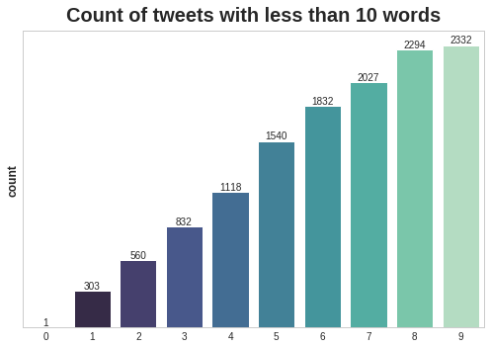
Tweet Length Analysis
Here, we basically plot tweets based on their counts and remove tweets that are too short (less than 4 words) and that are too long ( more than 100 words ).
This results in the number of samples after removing too short and too long tweets to be equal to 37113 rows.

Slide 10
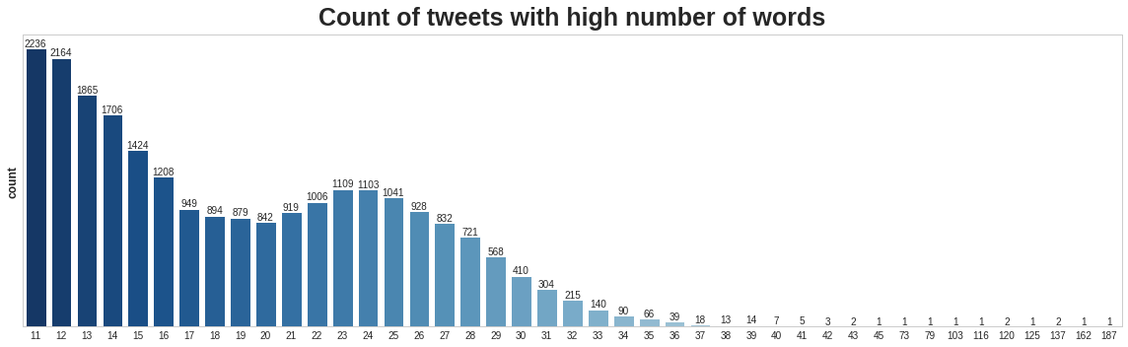
Tweet Length Analysis

Slide 11
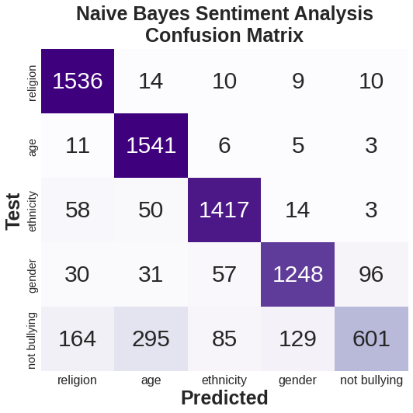
Naïve Bayes baseline model: As a simple baseline model
Create a bag of words using Count Vectorizer.
Instantiate the Naïve Bayes mode.
Construct the classification report for naïve bayes.
Construct the confusion matrix for the same.

Slide 12
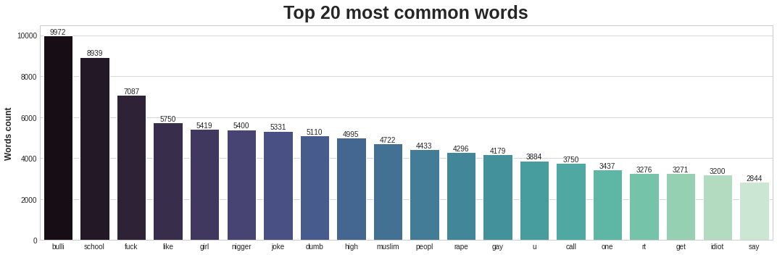
Custom Bidirectional LSTM
Extract top 20 most common words from the vocabulary dictionary we created with the tokenizer.
Word Embedding by Word2Vec: create a word embedding matrix using the original text tweets and the pre-trained model Word2Vec. First we create a list of words from the X train vector created before.

Slide 13
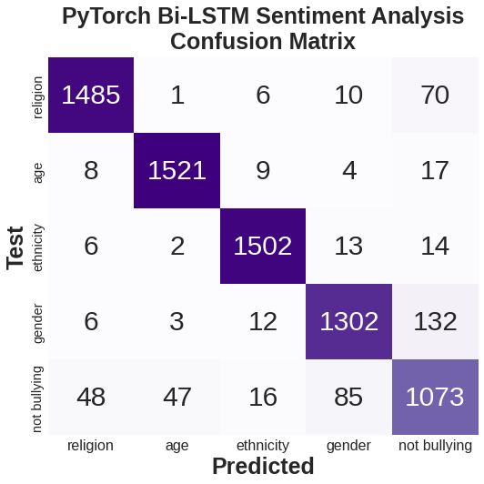
LSTM Modeling
We are dealing with a multiclass classification of 5 classes.
We train the LSTM with 5 epochs and then we test the LSTM to create a confusion matrix

Slide 14
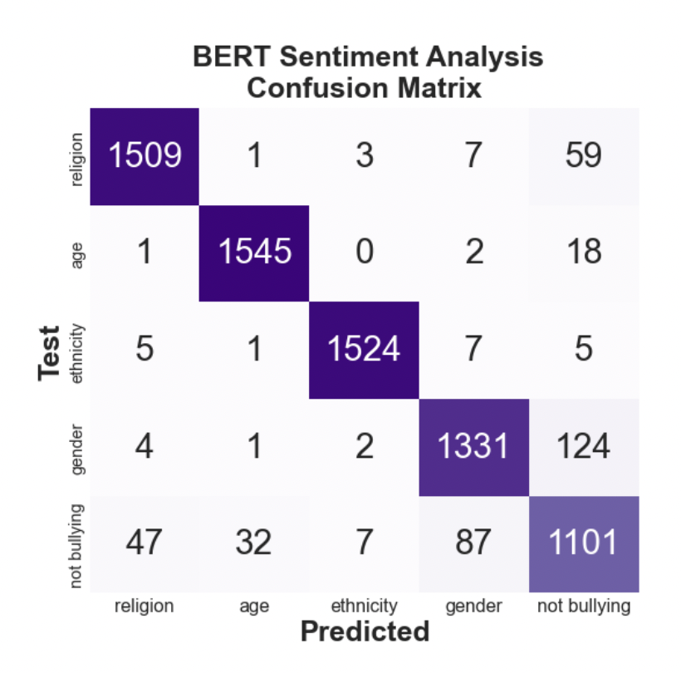
BERT Classification
Load a pre trained BERT model from the Hugging Face library and fine tune it for our classification task.
Split the dataset into train – validation and test data split. Also, download the pretrained model of BERT TOKENIZER.
Train the BERT model for 2 epochs since each epochs is time consuming. And further predict the classification report and construct a confusion matrix.

Slide 15
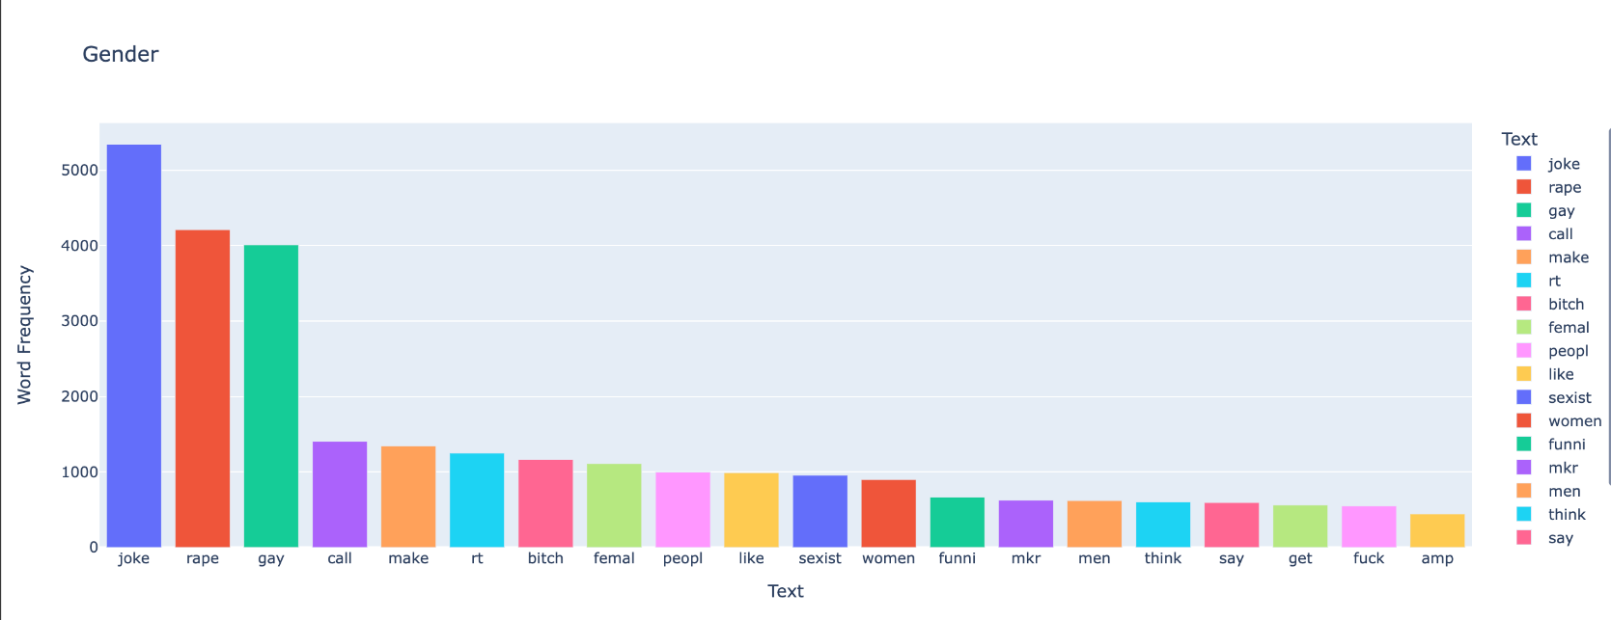
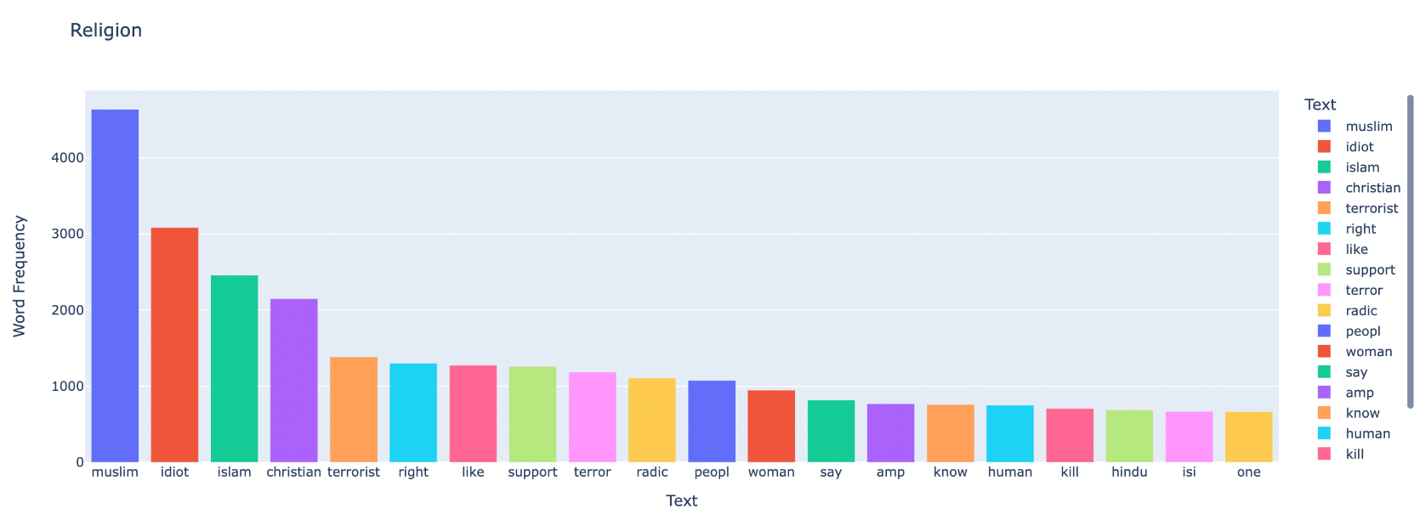
Cyberbullying Tweets Bar Graphs for Different Categories

Slide 16
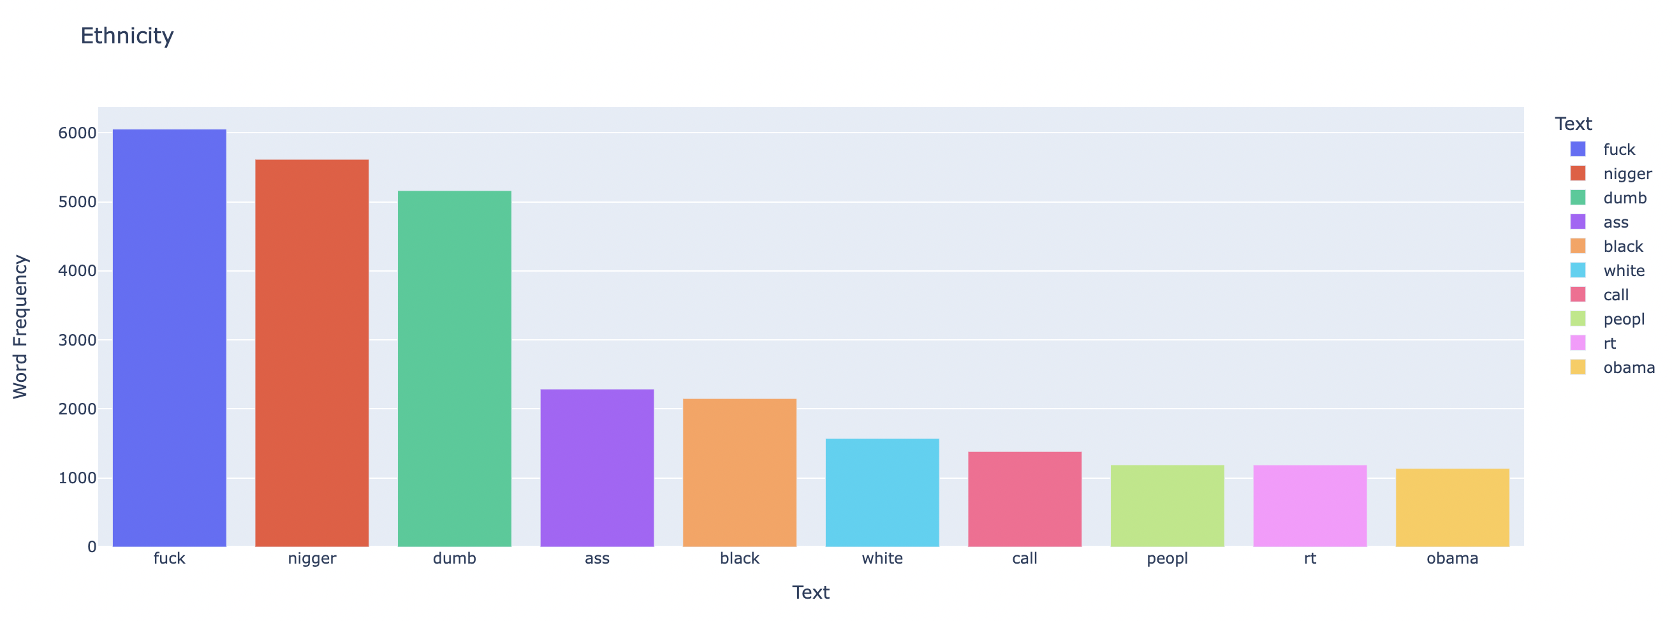
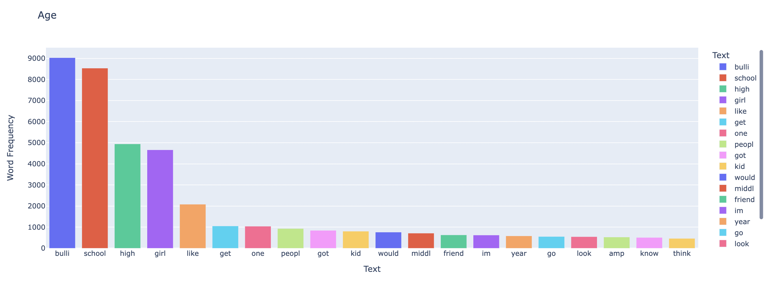
Cyberbullying Tweets Bar Graphs for Different Categories

Slide 17
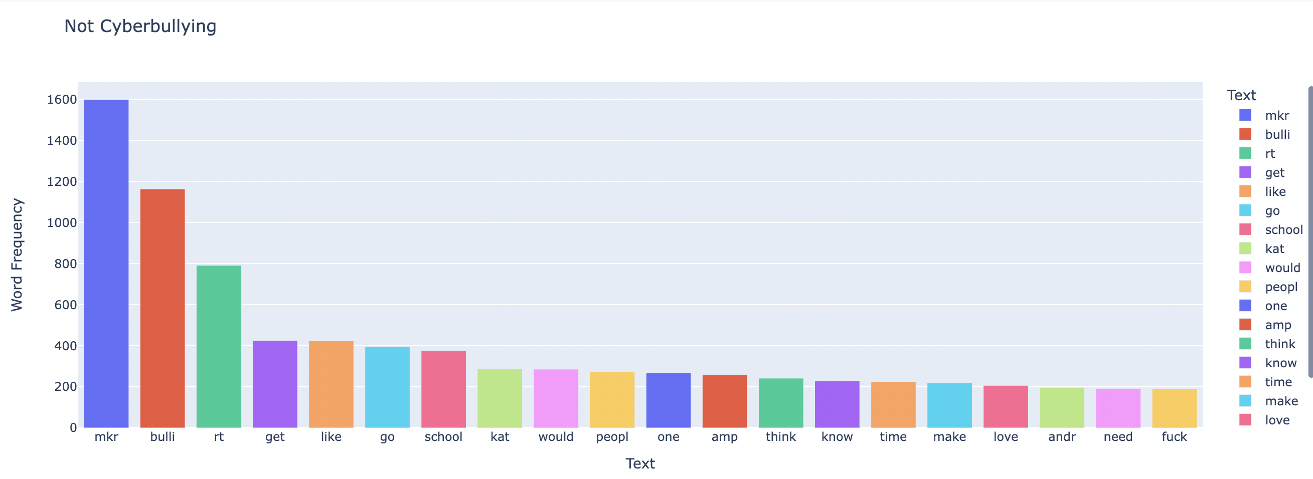
Cyberbullying Tweets Bar Graphs for Different Categories

Slide 18
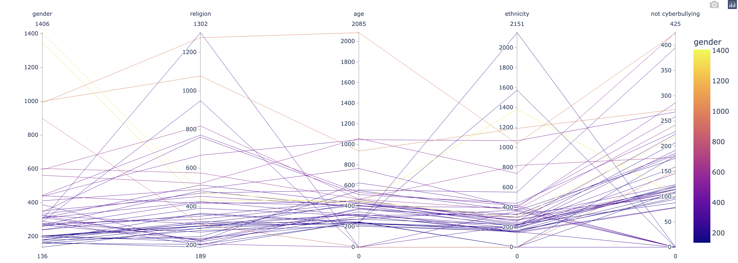
Parallel Coordinate Graph

Slide 19
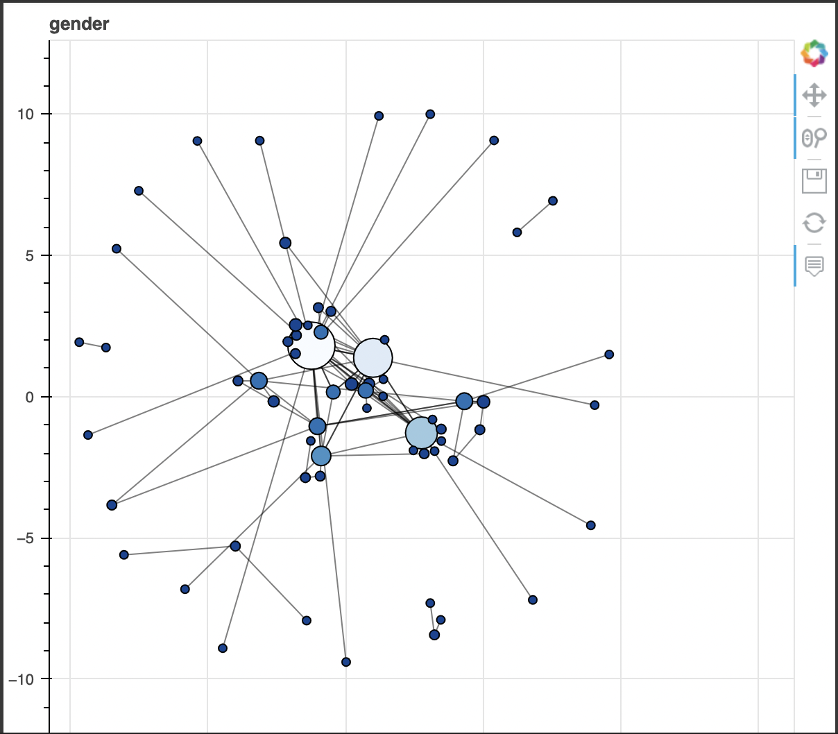
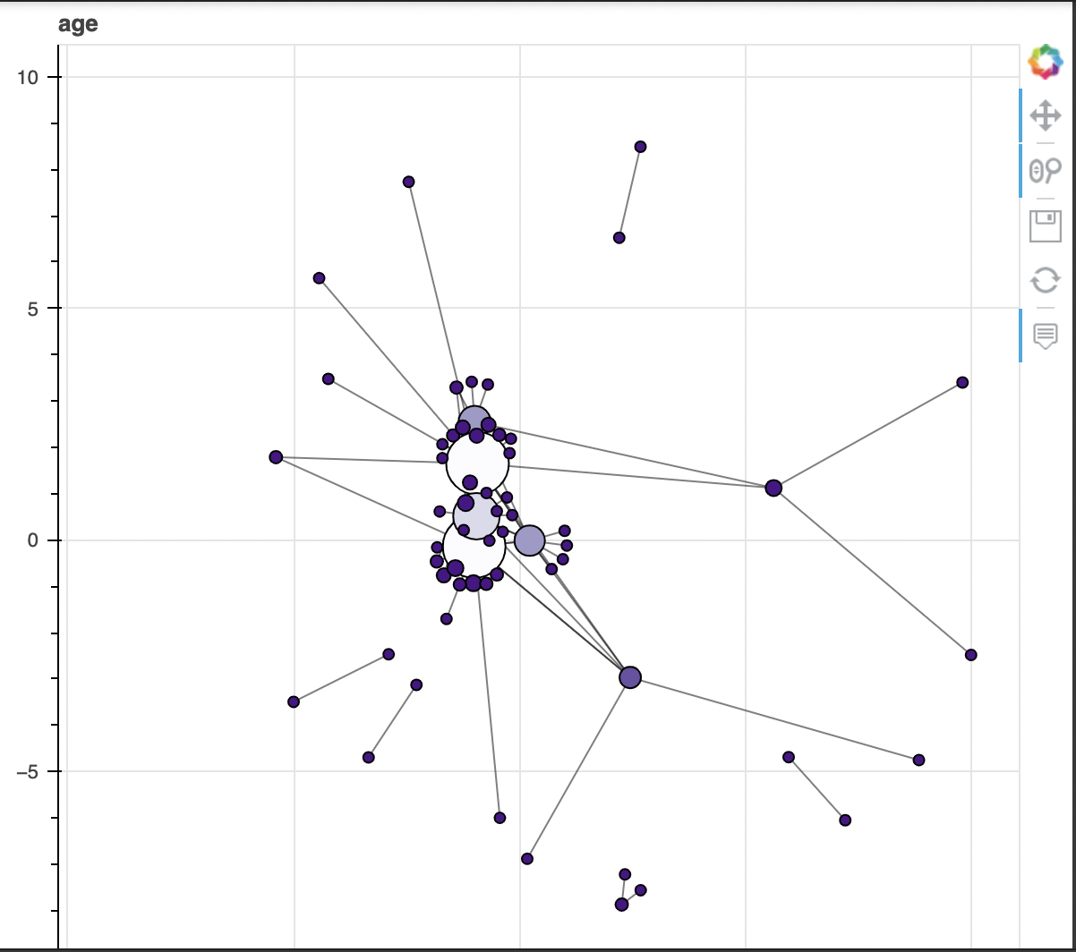
Network Analysis Graphs

Slide 20
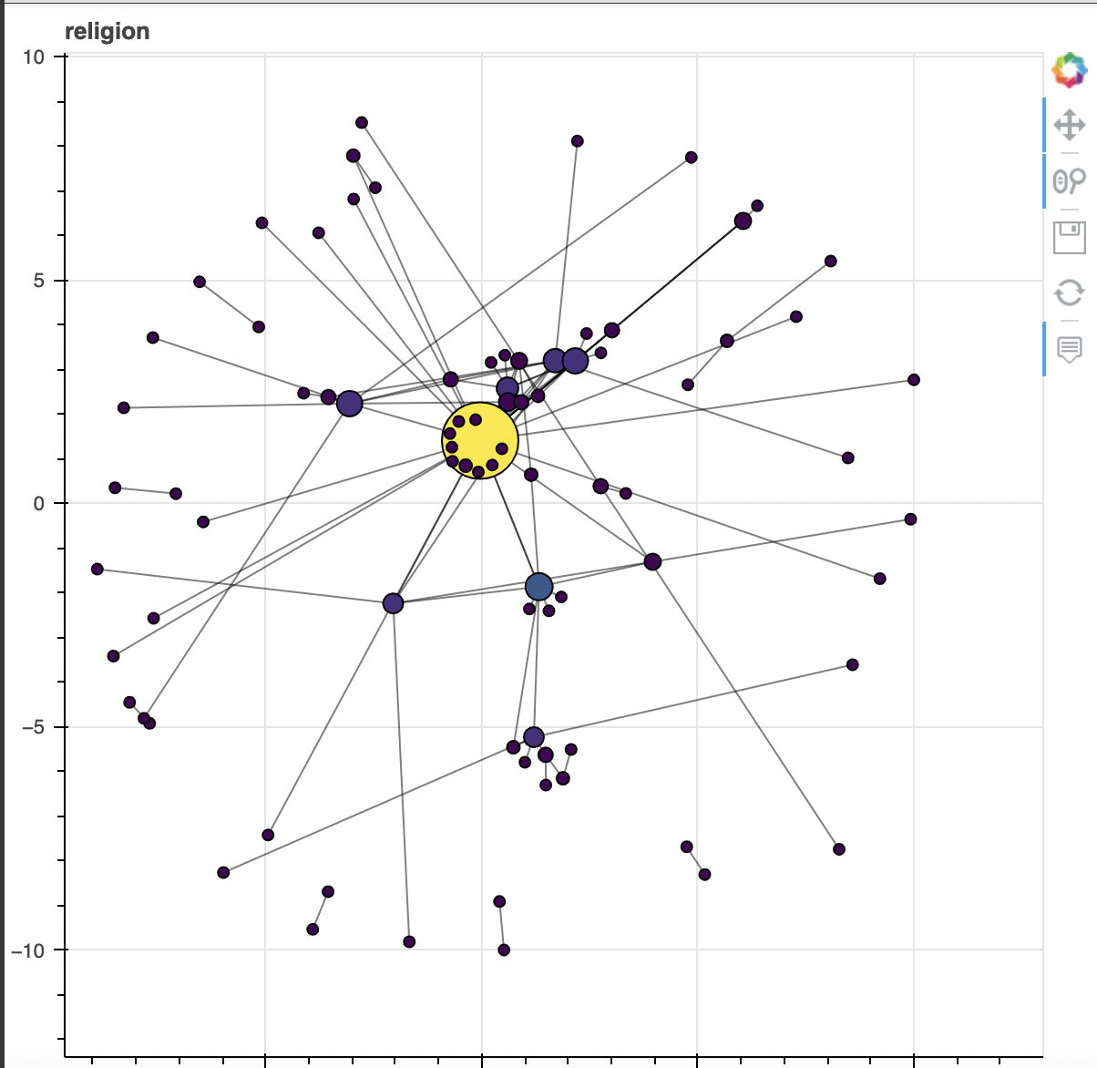
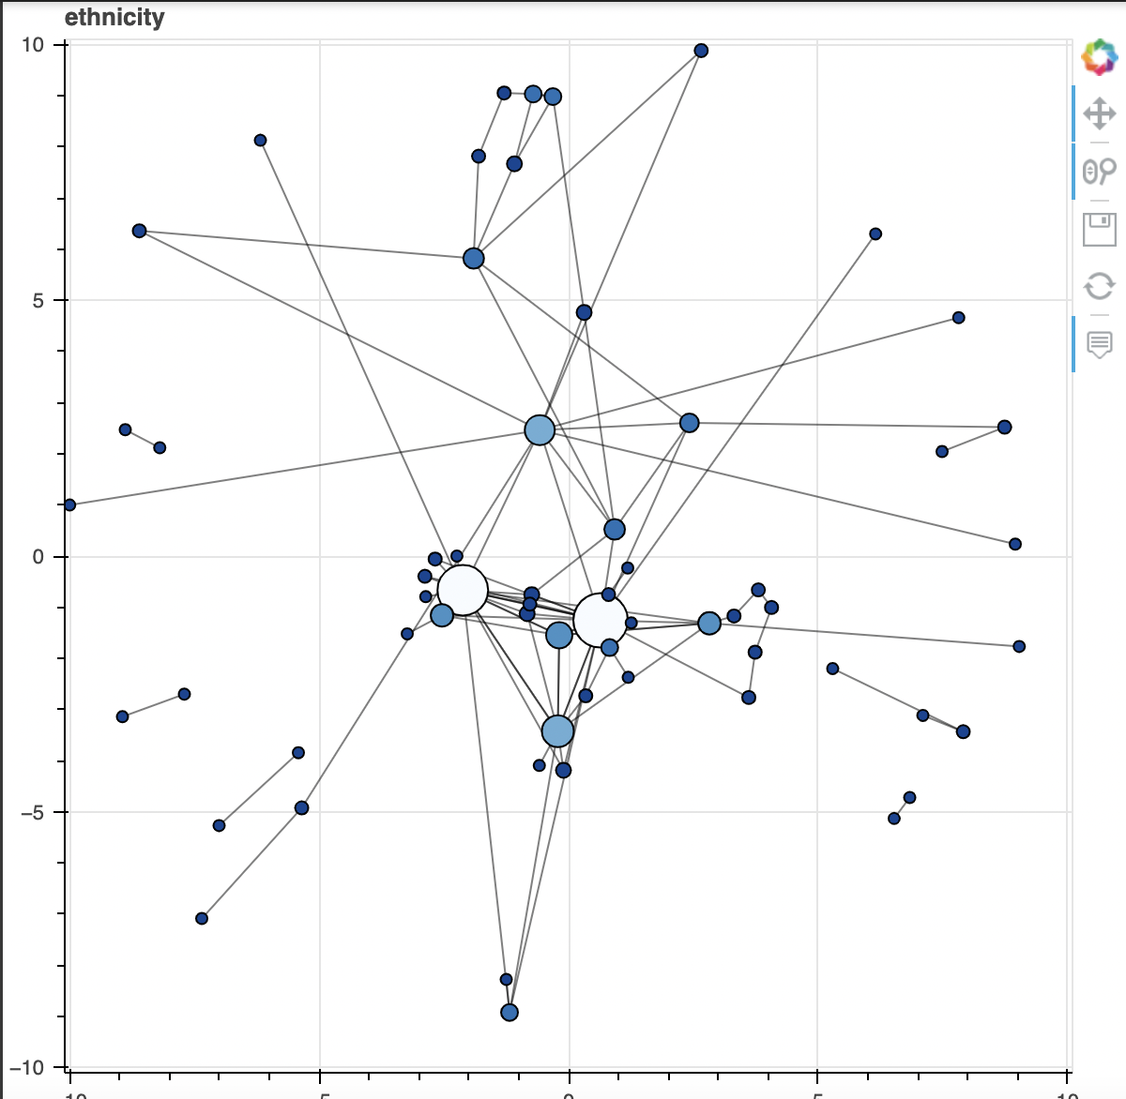
Network Analysis Graphs

Slide 21
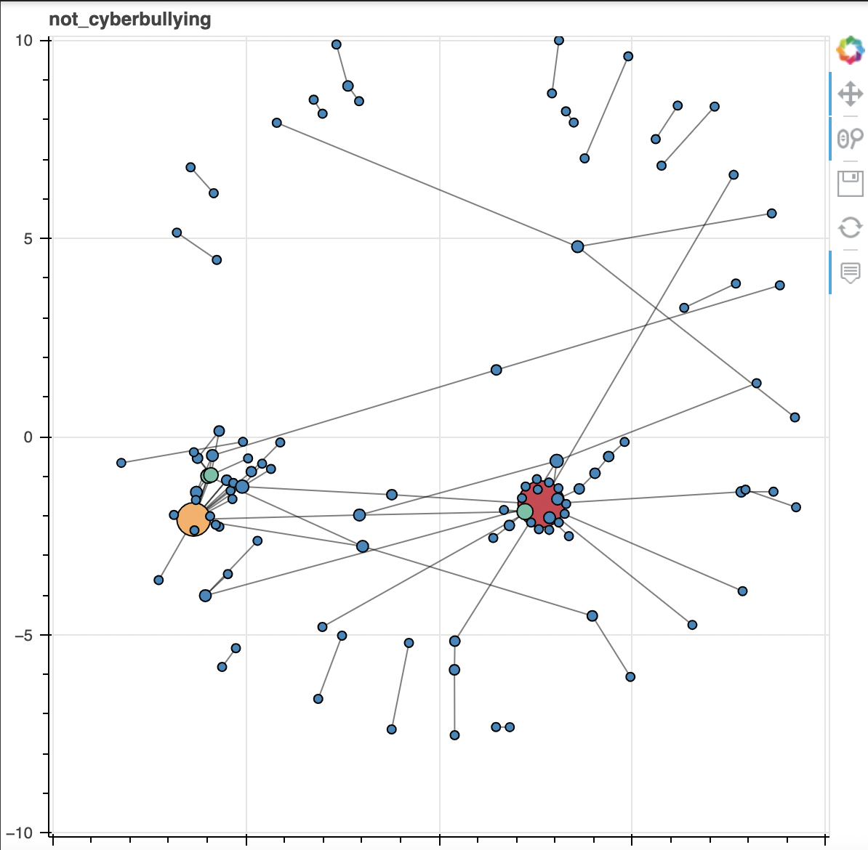
Network Analysis Graphs

Slide 22
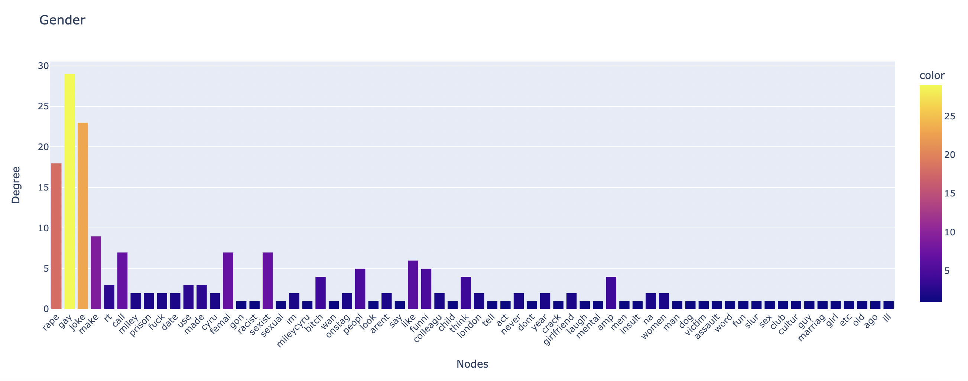
Plotting Bar Graphs to represent degree of each node in each category

Slide 23
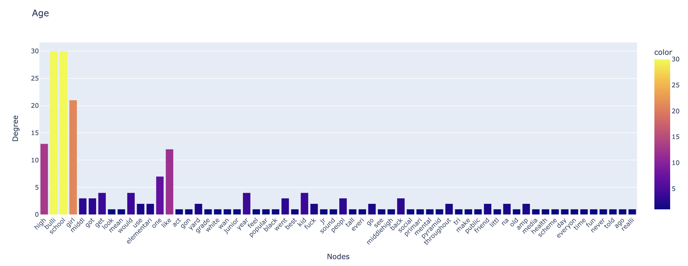
Plotting Bar Graphs to represent degree of each node in each category

Slide 24
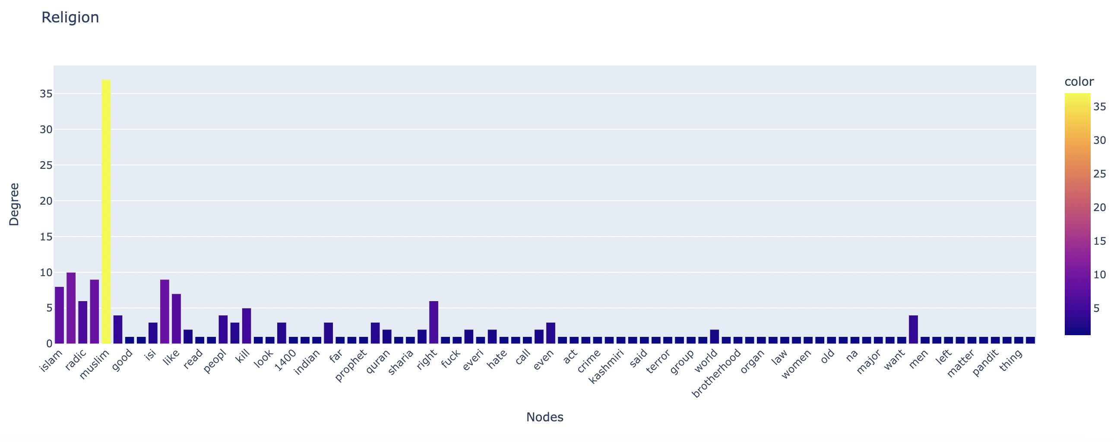
Plotting the degree of each node in each category

Slide 25
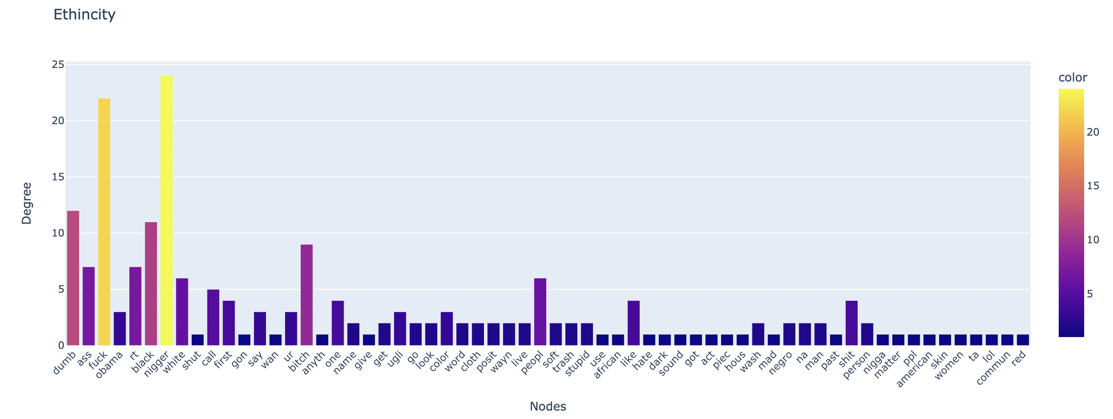
Plotting Bar Graphs to represent degree of each node in each category

Slide 26
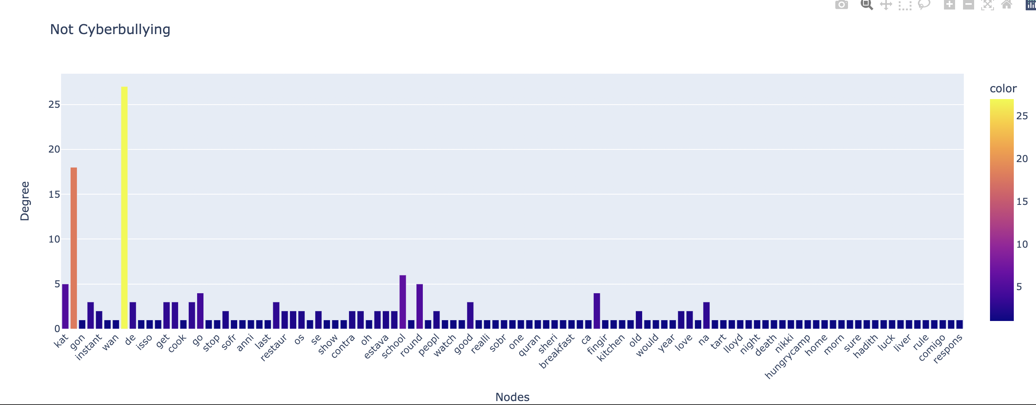
Plotting Bar Graphs to represent degree of each node in each category

Slide 27
REFERENCES & RELEVANT WORKS
Alotaibi, M.; Alotaibi, B.; Razaque, A. A Multichannel Deep Learning Framework for Cyberbullying Detection on Social Media. Electronics 2021, 10, 2664.
Pereraa & Fernandob, 2020, Accurate Cyberbullying Detection and Prevention on Social Media, CENTERIS
Van Hee, C., Jacobs, G., Emmery, C., Desmet, B., Lefever, E., Verhoeven, B., De Pauw, G., Daelemans, W., & Hoste, V. (2018). Automatic detection of cyberbullying in social media text. PloS one, 13(10), e0203794
Lepe-Faúndez, M.; Segura-Navarrete, A.; Vidal-Castro, C.; Martínez-Araneda, C.; Rubio-Manzano, C. Detecting Aggressiveness in Tweets: A Hybrid Model for Detecting Cyberbullying in the Spanish Language. Appl. Sci. 2021, 11, 10706
Alotaibi, M.; Alotaibi, B.; Razaque, A. A Multichannel Deep Learning Framework for Cyberbullying Detection on Social Media. Electronics 2021, 10, 2664
J. Wang, K. Fu, C.T. Lu, “SOSNet: A Graph Convolutional Network Approach to Fine-Grained Cyberbullying Detection,” Proceedings of the 2020 IEEE International Conference on Big Data (IEEE BigData 2020), pp. 1699-1708, December 10-13, 2020

